Slide 1
Changes to Big Mountain Resort
Reduce operating costs and increase ticket price

Slide 2
Operating Costs and Solutions
The addition of the new chair increases operating costs to $1,540,000 per season.
We to manage this, I suggest a plan to reduce operating costs by removing unnecessary facilities. What facilities can be changed?
Another solution is to increase the price per ticket. What facilities will support and increase in ticket price?

Slide 3
Recommendation and Key Findings
Visitors value fast quads, number of runs, snow making coverage(acres), and vertical drop.
Install a fast quad chair
Increase vertical drop by 150 feet which would require a new chair installation
Increase snow making coverage
Close down 3-5 most unused/unpopular runs to lower operating costs of maintaining and grooming those runs and the chairs that are needed to access those runs.
My recommendation would be to include these changes into your business model to cover the cost of operation and installation. By including these features you can charge up to an addition $15 at $95 and have a revenue of about $15 million dollars after account operating costs.

Slide 4
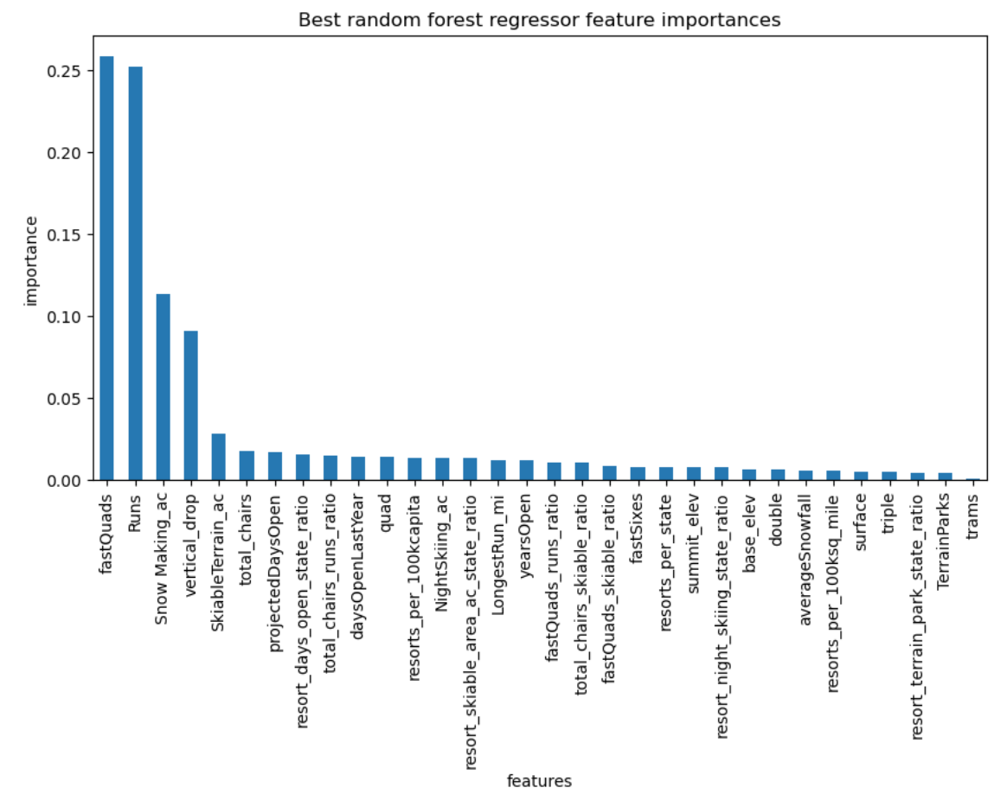
Facilities values by visitors

Slide 5
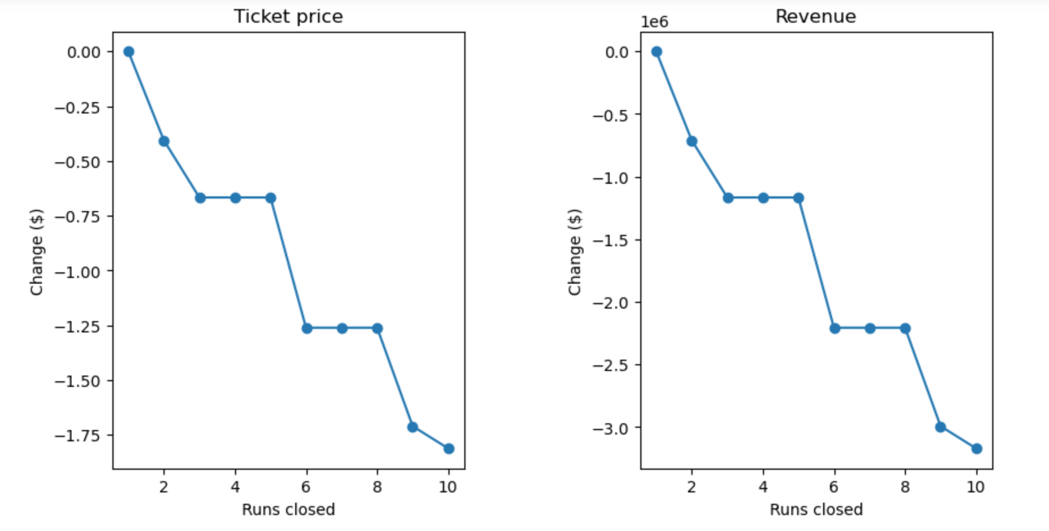
Why close 3-5 runs?
Close 3-5 of the least used runs. This will reduce the operating cost of the chairs needed to access those runs and maintenance on those runs. This will only slightly reduce the cost of a ticket, but significantly reduce operating costs. Closing 3-5 runs will hold the same value in the decrease in a cost of tickets

Slide 6
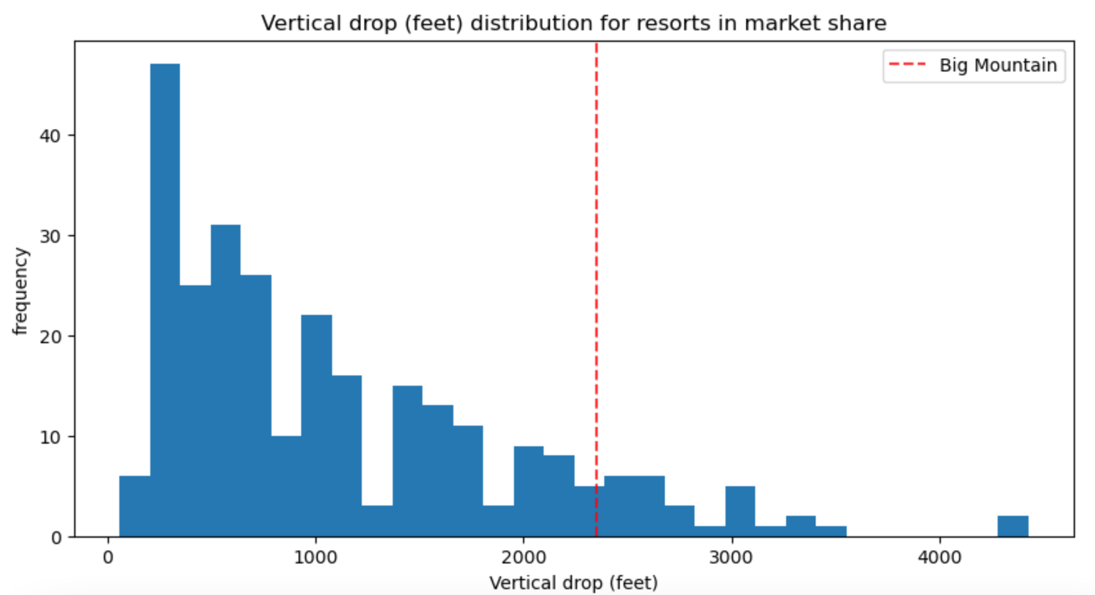
Increasing Vertical Drop
Increasing the vertical drop support and increase of ticket price by $8.61. This would total to $15,065,371 with an estimate of 350,000 visitors purchasing 5 day passes. This is where we fall with our competitors.

Slide 7
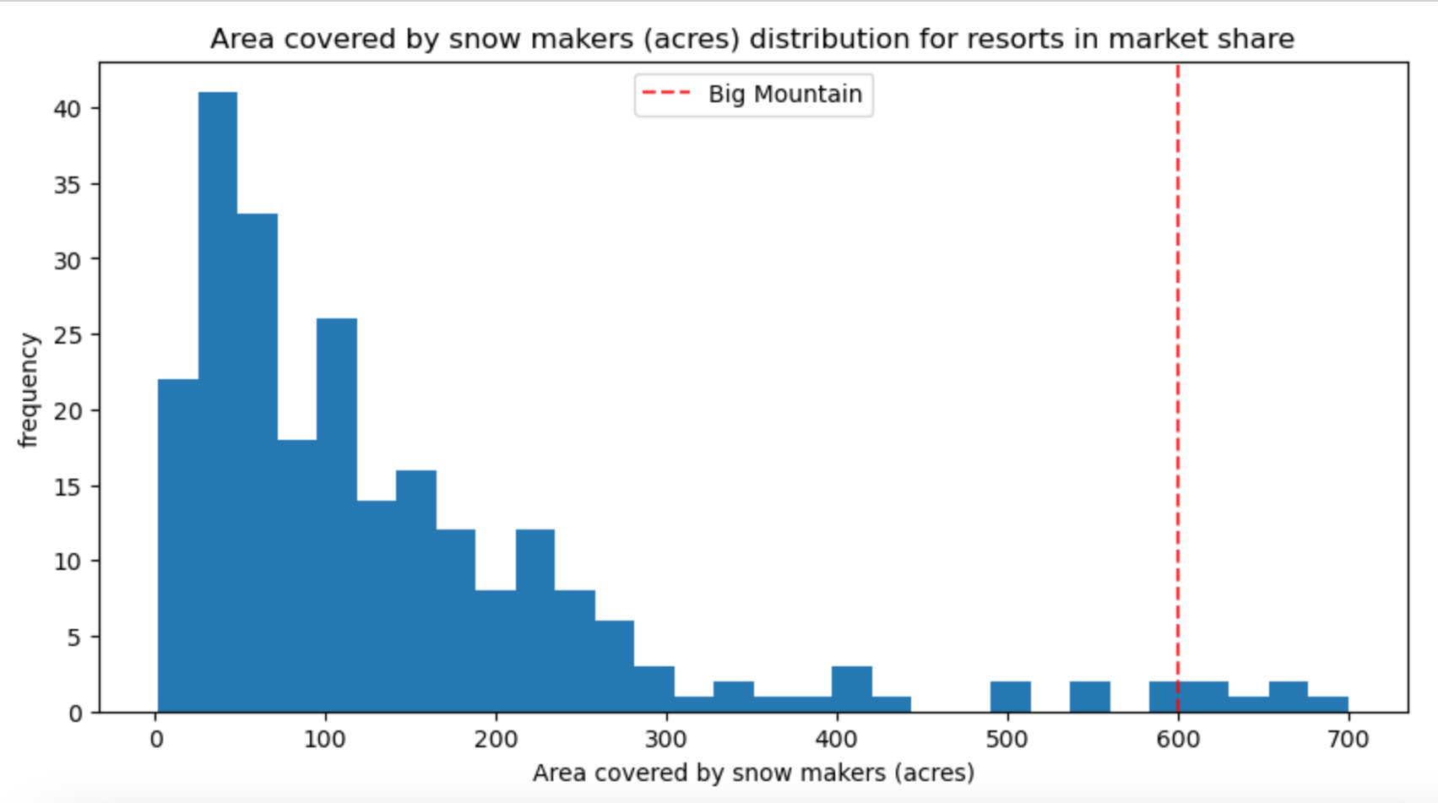
Increase Snow Making Coverage
Increasing the snow making coverage also supports an increase in price by $9.90. With an estimated 350,000 visitors purchasing 5 day passes, this would amount to $17,322,717. This is where we fall with our competitors.

Slide 8
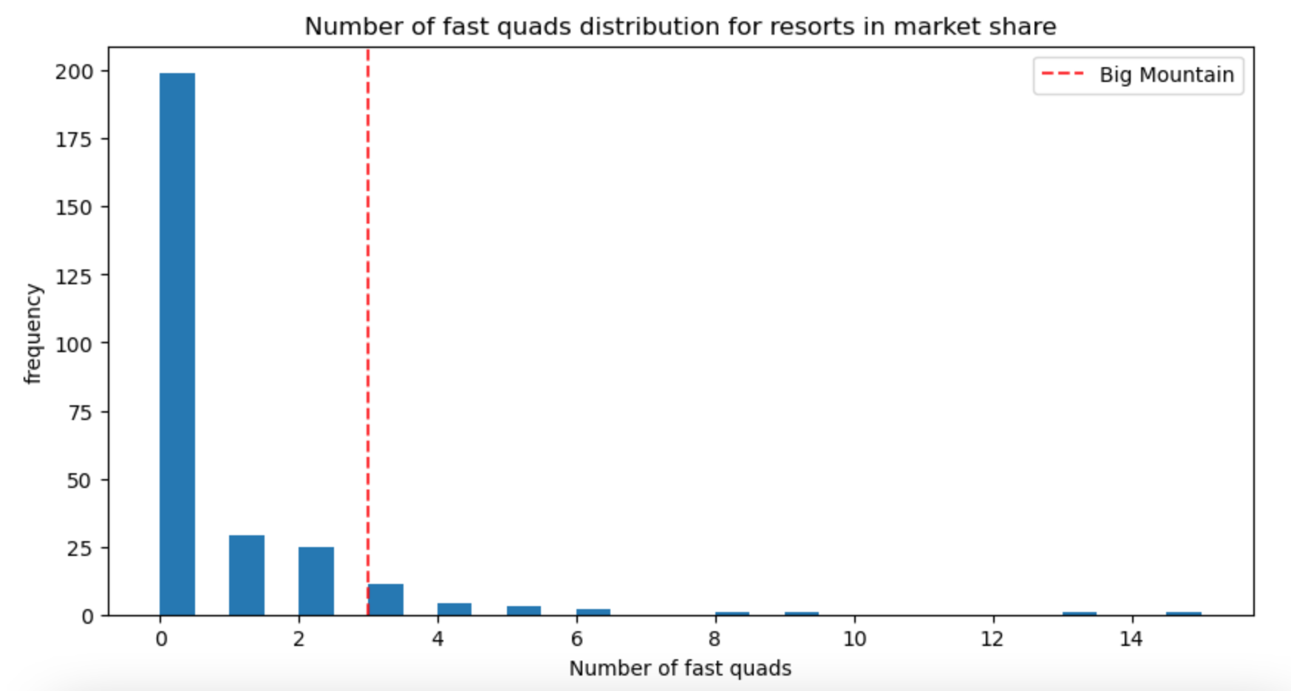
Fast Quad
Installing a fast quad would be ideal for the next installation. With very little mountains offering this service, it would fully support the increase in ticket prices.

Slide 9
Sum It Up
Having a larger vertical drop, more snow making coverage, and an additional fast quad chair will strongly support an increase to ticket prices. And the closure of a few runs and chairs will only decrease the price of tickets by maybe a dollar.
With these changes, Big Mountain would still make over $15,000,000 per season, Even with the increase in operating costs and installing these facilities.

